Slide 1
Why docs-as-code peer review should be part of your dev cycle
Joanna Suau, Developer Educator at Infobip

Slide 2
joanna.suau@infobip.com
jo-suau
JoannaSuau
joanna.suau
Joanna Suau, Developer Educator at Infobip
Notes:
Background about technical writing

Slide 3
Notes:
Infobip is a global communication platform offering a whole bunch of messaging APIs.
Part of the DevRel team who's on the mission of helping developers achieve the most effective onboarding and smooth developer experience when using Infobip products.

Slide 4
Show how developers and technical content creators can collaborate under one process
AIM:
Notes:
Empower both sides to set up the most efficient collaboration process for better quality end result which is amazing USER EXPERIENCE of both software and documentation.

Slide 5
About this talk...
DOCS-AS-CODE
DEVELOPER CYCLE
CONTENT
Define the docs-as-code methodology and best practices
Describe the difference between the standard content review
Examine where in the cycle docs review should take place
Describe the benefits for the cycle
Describe the benefits for the content
Notes:
Now we know what I'm going to be rambling on about let's get started

Slide 6
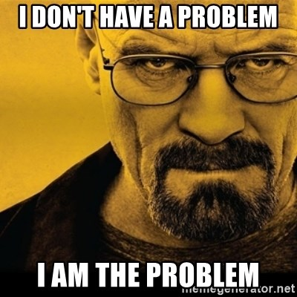
The problem with the traditional review
Notes:
To emphasize the thought that it doesn't work with developer documentation

Slide 7
The problem with the traditional review
Tooling plays a big role​
Notes:
Typically, it's difficult to share a single sourced copy between various reviewers.
Limited by license requirements.
Needs to be manually added to the source file

Slide 8
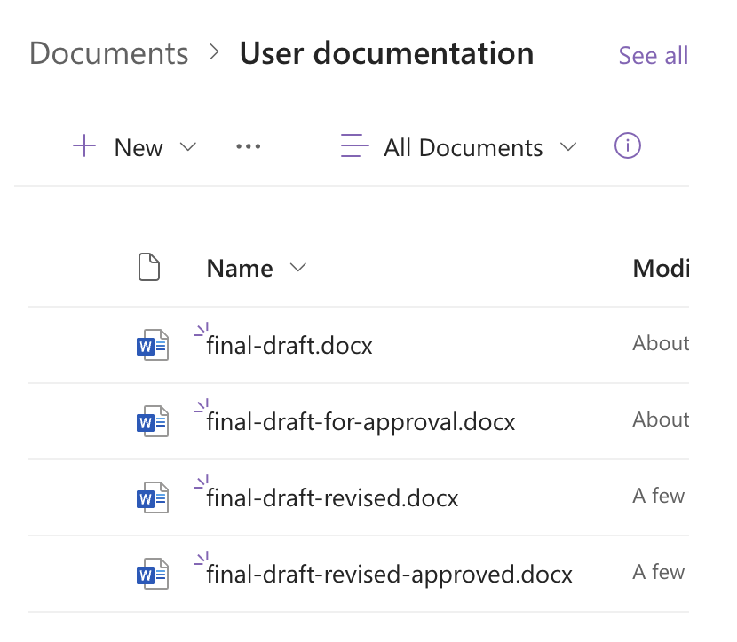
The problem with the traditional review
Multiple versions of the source file​
Notes:
-prone to human error and potentially valuable content being lost in the process

Slide 9
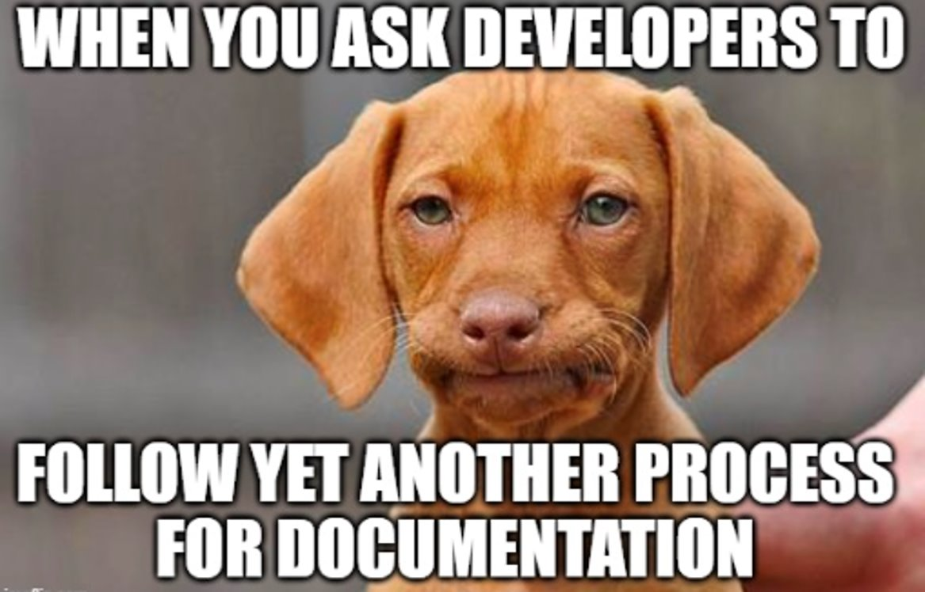
The problem with the traditional review
Needs a clearly defined process​
Notes:
Need a clearly defined process on how to access a document, how to add comments/edit it, what's expected of said review

Slide 10
The problem with the traditional review
Not easy to incorporate multiple reviewers' feedback​
Notes:
As controversial as I may sound, resolving a conflict on your branch is way less work than incorporating feedback from many different files.

Slide 11
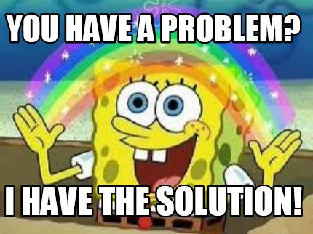
Is docs-as-code the answer?
Notes:
To emphasize the thought that it work with developer documentation not necessarily with other types of content like marketing content that can totally have a different cadence to a developer cycle

Slide 12
Docs-as-code in a nutshell
Notes:
this paragraph encapsulates docs-as-code approach

Slide 13
Docs-as-code in a nutshell
Notes:
this paragraph encapsulates docs-as-code approach

Slide 14
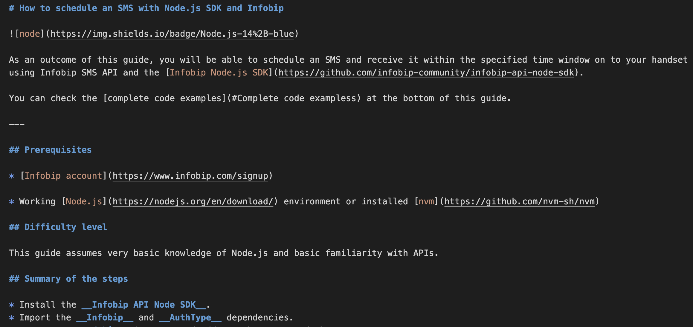
Key aspects of docs-as-code
Typically written in plain text format​
Notes:
Universally accessed. You don't need any special equipment, software, license, or permissions to open a text file.
Styling abstracted from review, taken care of an automated process, e.g. markdown linting plug-in; there's no need for a human reviewer.

Slide 15
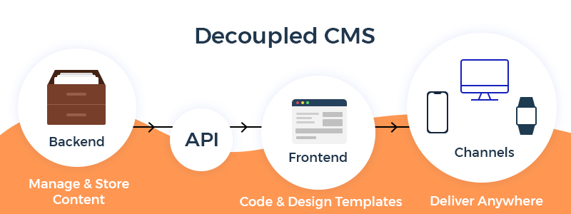
Key aspects of docs-as-code
Decoupled frontend and backend​
Stored in a version control system
Uses automated testing and deployment tools
Uses issue trackers
Notes:
Frees the technical content team from having to deal with the page design and content elements styling
Content team solely focuses on content itself they don't resolve any frontend-related issues
content-focused approach:
content structure
content findability
information architecture (content silos, buckets)
user journey (how to navigate through content and link it all together in a logical way)

Slide 16
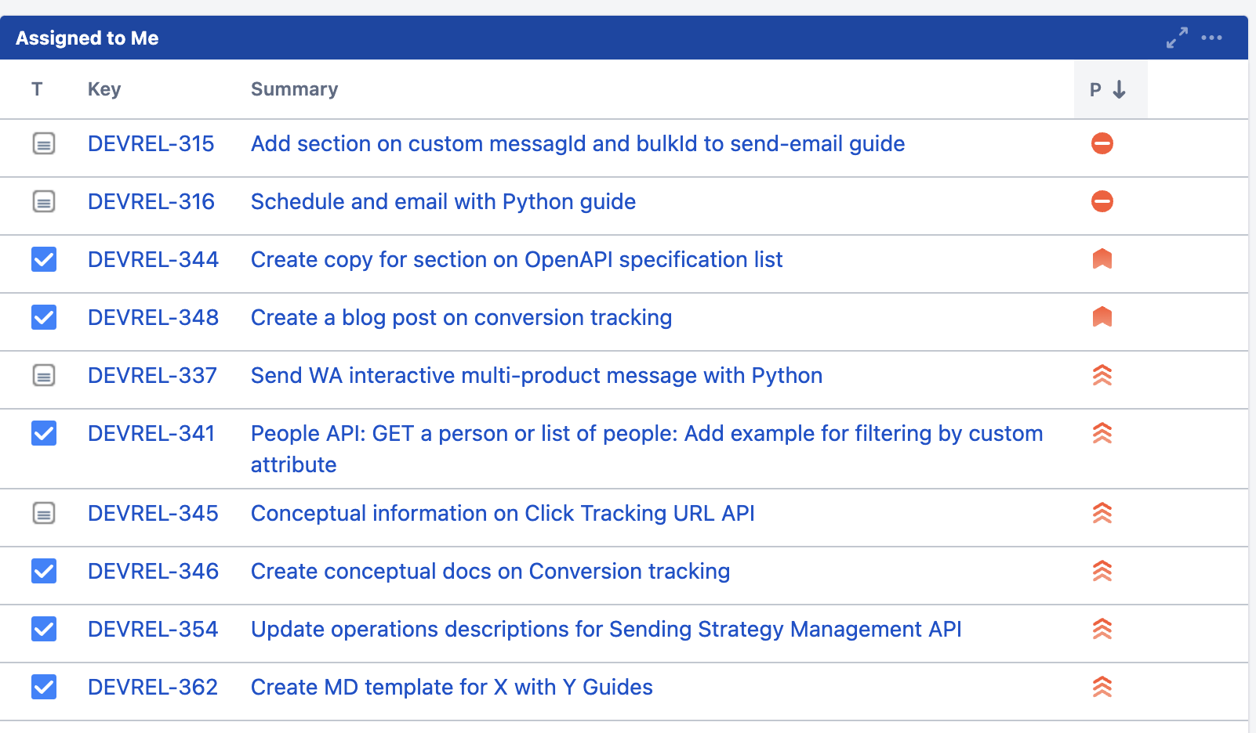
Key aspects of docs-as-code
Uses issue trackers​
Notes:
Same tools, same process = efficient
Better estimates for doc effort = Better quality collaboration between teams
SUMMARY: Documentation effort can be measured

Slide 17
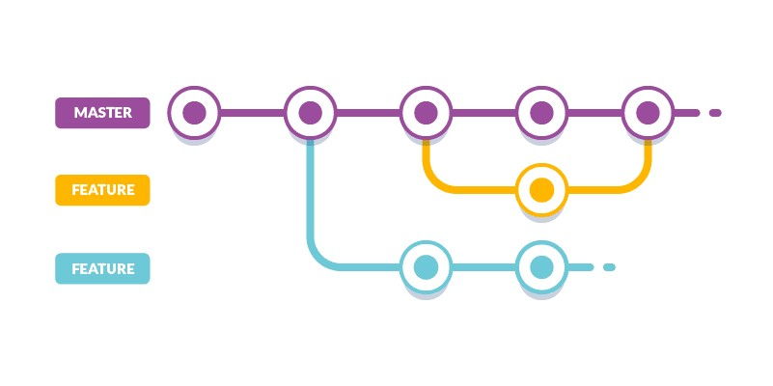
Key aspects of docs-as-code
Stored in a version control system​
About git branching
Notes:
To add simplicity the VCS would typically be the same one already used by the dev team: easy to access by anybody who needs it
Main assumption of the docs-as-code process is to use git-based product to mirror a development process why git-base is important: enhances COLLABORATION that is a core benefit of the docs-as-code approach. Allows for offline and concurrent work on the same file from different people. Tech writers branch, merge, and track changes to the documentation just like developers do with their code.
Encourages openness and efficiency across teams in a company

Slide 18
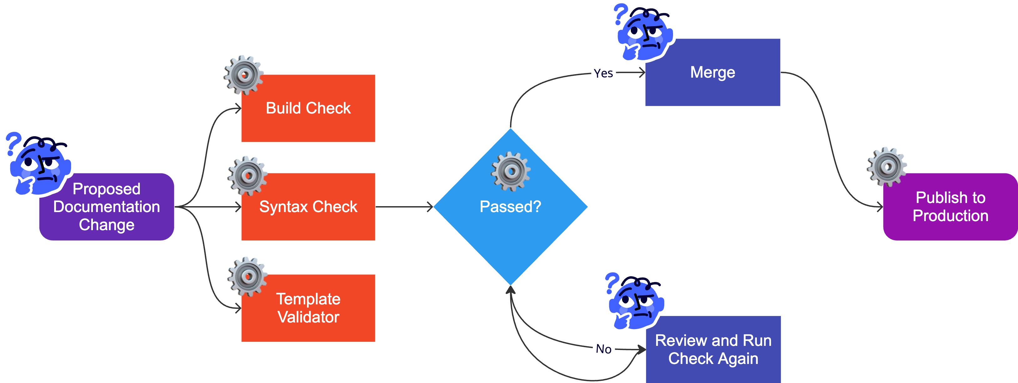
Key aspects of docs-as-code
Uses automated testing and deployment tools​
Notes:
Standard deployment process
Static site generator with some automation tools to stick to the CI/CD method
What to automate: template validation – enforcing certain structure based on the content type syntax – enforcing certain syntax rules, e.g. no HTML code in your MD because you want to use an output that doesn't support it like PDF single sourcing: MongoDB and their automation process to pull the code straight from repo into docs - single sourcing of code samples

Slide 19
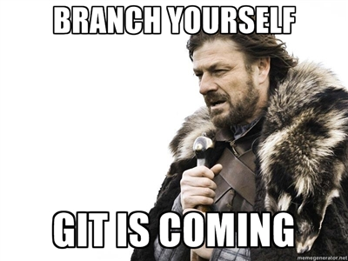
What’s docs-as-code peer review?

Slide 20
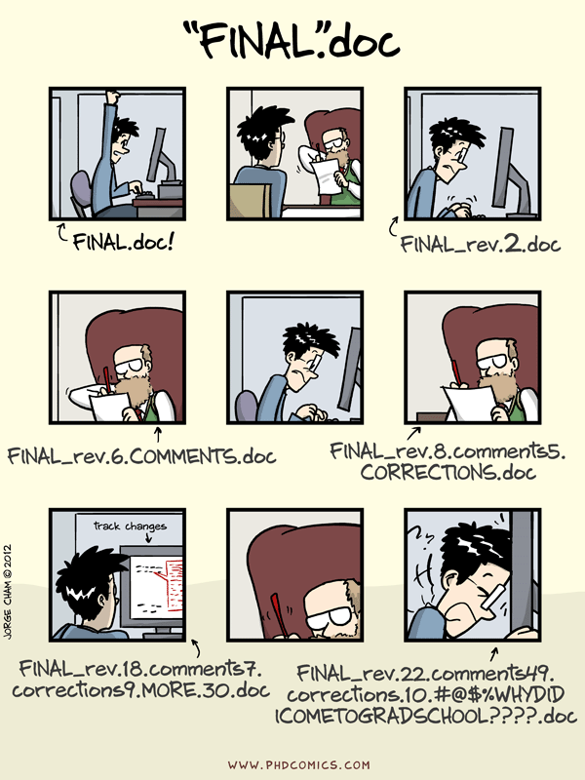
Key aspects of docs-as-code peer review
Built on a foundation of version control​
Notes:
No multiple files but rather multiple versions of one file.
Encourages having multiple reviewers all backed up by the principle of single sourcing and governed by version control

Slide 21
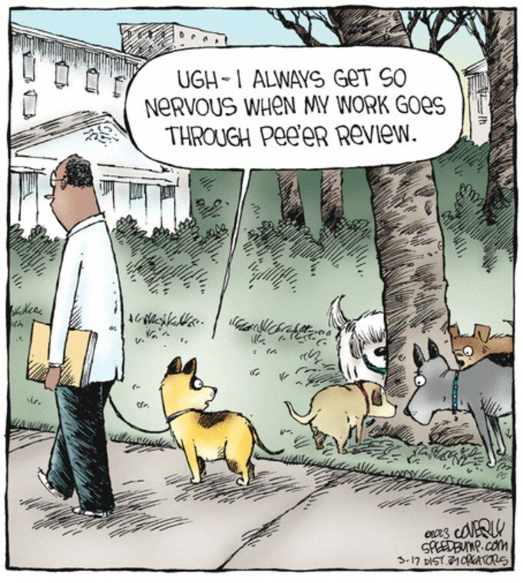
Key aspects of docs-as-code peer review
Easily incorporates multiple reviewers' feedback​
Notes:
Elevates the quality of the document.
Enhances docs' point of view. Engages not only SME but also, people with various job titles who offer their unique perspective: testers, POs, PMs, other devs not involved in the project;

Slide 22
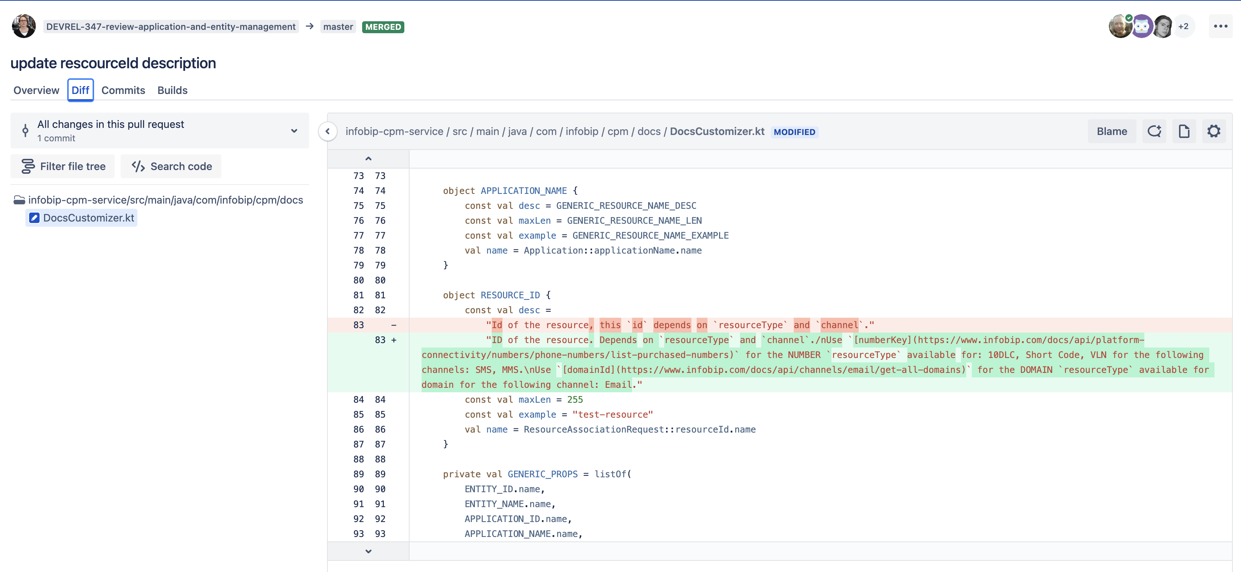
Key aspects of docs-as-code peer review
Uses code review tools​
Notes:
Same tools for dev and doc team
Encourages more collaboration possibilities for both teams: technical authors can participate in code reviews to review in-line comments, documentation tags in your XML projects or description tags in YAML, READMEs, etc.

Slide 23
Key aspects of docs-as-code peer review
Uses a familiar process​
Notes:
Minimizes the risk of documentation getting overlooked; feels more natural
industry standard for the development world

Slide 24
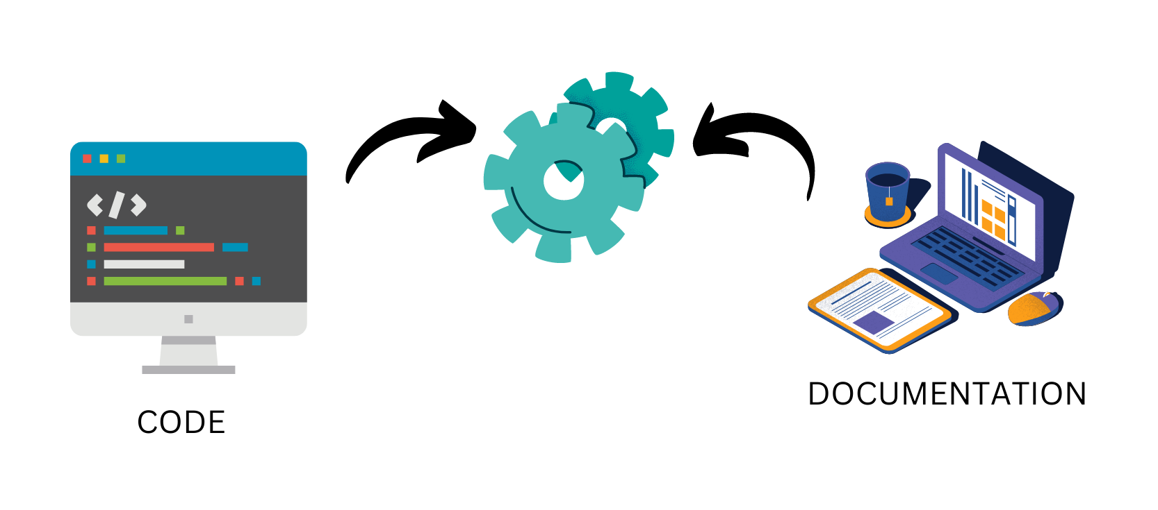
Docs-as-code approach in a dev cycle
Notes:
One universal environment into which both code and documentation is incorporated in a similar manner.

Slide 25
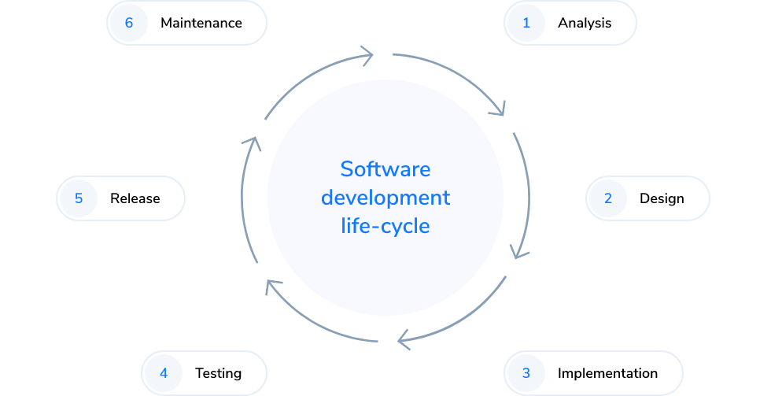
Docs-as-code approach in a dev cycle
Notes:
Q for next slide: When do we write docs and when do we review them?
Next slide will show you how to strap a documentation cycle to the dev cycle

Slide 26
Docs-as-code approach in a dev cycle
Maintain
Identify docs
Publish
Draft
Review
Write
About documentation cycle
Notes:
Documentation cycle running alongside the development cycle

Slide 27
Benefits for the dev cycle
Same process for code and documentation
Code and documentation updated in parallel
Documentation easily accessible for every stakeholder

Slide 28
Benefits for the dev cycle
Same process for code and documentation
Code and documentation updated in parallel
Documentation easily accessible for every stakeholder
Notes:
SAME PROCESS: efficiency, empowers collaboration, cost-effective
CODE & DOCS UPDATED: documentation not treated as an afterthought
EASILY ACCESSIBLE: empowers everybody to contribute to documentation - adds more context to your docs

Slide 29
Benefits for documentation
Always up to date
Efficient and clear review process
Improved quality

Slide 30
Benefits for documentation
Always up to date
Efficient and clear review process
Improved quality
Notes:
UP TO DATE: inherent part of the process, difficult to overlook it
EFFICIENT PROCESS: everybody is familiar with so it's time-efficient and more people can participate, industry standard
IMPROVED QUALITY: Well planned documentation, adapted to user needs, not thrown together in a hurry SUMMARY: More COMPREHENSIVE documentation

Slide 31
joanna.suau@infobip.com
jo-suau
JoannaSuau
joanna.suau
Notes:
Ask questions now, or reach out to me at the booth or on any of the socials provided

